Slide 1
Informatics 312
Enterprise Risk Management

Slide 2
Welcome
I will have office hours by appointment. You have only to email us to set up a convenient time.
This course is being taught synchronously, with my slides posted within 24 hours of class
Please review syllabus carefully for academic policies on
Academic Integrity and Proper Citations
Copyright
Privacy
Code of Conduct
Accommodations and Attestations
All assignments should be submitted from Canvas. Announcements or discussions are also handled from Canvas.
Please set your alerts in Canvas for immediate notification of announcements.

Slide 3
Class Expectations
This is a course that wrestles with concepts that resist easy generalization or quick summation, and that rewards patient and rigorous interpretation and inquiry.
That you will be present and participate actively.
That Chatham House Rules will be observed.
That thinking on your feet and writing clearly are traits that will stand you in good stead this quarter.
That at least some of the papers submitted will be of publishable quality.
All class will require your attendance. If you are unable to attend class, please note that it is your responsibility to review the powerpoint slides for the weekly small group report.
Under certain circumstances, the course may revert to an online format – I will inform the class ahead of time via announcements and email.

Slide 4
Introductions – Andy Herman
MS Information Management- University of Washington
Governance Risk and Compliance, Risk Management Strategy Lead - Meta
Regulatory Compliance Program Lead - Google
Governance, Risk, and Compliance Program Lead (Mixed Reality) - Microsoft

Slide 5
Introductions – Andy Herman
Husband, Dad to two beautiful daughters
Avid Golfer, Hobby Archer
Soccer Fan, Husky Football Fan (Yes, even this year!)
Graduated from UW for both Undergrad and Masters Program
Founder of UW ISACA Student Group

Slide 6
Class Format
Monday and Wednesdays will each have their own rhythm.
Monday -- Lecture/Small Group Reports, during which I expect to be asked questions and engage in discussion with you. The lecture may or may not be focused primarily on the reading assignments. Its PowerPoint will be posted after class on the website. This is also the day we will hear a small group perform a risk review of an historic event.
Wednesday – Lecture/ Risk Review Debates. Each group that is not part of the critique and defense team must participate in the audience questions section in order to obtain participation points for the debates. Please see the syllabus section for details on the debates.

Slide 7
Group Work is 45% of the grade
Two groups will be the primary participants of the Risk Review (Debates), starting in Week #3
Every Monday, we’ll do a Small Group Report session in class.
I’ll present a question, and you’ll sit with your teams to discuss and come up with an answer.
One person in your group needs to be the scribe and turn in your written report at the end of class by posting your presentations to the appropriate discussion board week.
That report also needs to list the names of those present, so credit is provided to the right people.
If you miss class, you have the option of looking up the question in the slide deck, setting a timer for 20 minutes and writing up your answer. You must send this to Michaela and note the date, the question and your answer.
Each group will be given 5 minutes to present on their responses at the end of class

Slide 8
Expectations – Debate Details
Critique Team
will recognize the losses from the risk as unacceptable and will provide a rationale for why the risk management was poorly handled.
Defense Team
will have the task of representing and defending the actions of the enterprise or organization primarily responsible for any losses incurred.

Slide 9
Risk Review Debates
Jan 22: Facebook & Cambridge Analytica
Jan 29: Solarwinds
Feb 5: Microsoft Recall AI (2024)
Feb 12: National Public Data Breach (2024)
Feb 19: Apple-FBI encryption
Feb 26: Breach of telecommunication providers by China (2024)
Mar 5: BP Deepwater Horizon Oil Spill
Group 5 – Critique/ Group 2: Defense
Group 3 – Critique/ Group 6: Defense
Group 7 – Critique/ Group 4: Defense
Group 2 – Critique/ Group 1: Defense
Group 6 – Critique/ Group 7: Defense
Group 1 – Critique/ Group 3: Defense
Group 4 – Critique/ Group 5: Defense

Slide 10
Midterm/ Final Papers
Students will write two papers, one due mid-quarter (5 pages) (20%), and the other due at the end of the quarter (10 pages) (25%), from which you will also prepare an executive five-minute summary of it to present to the class (10%).

Slide 11
Criteria for Grading Short and Long Papers
Response Content (60%) Demonstrates significant mastery of core concepts*** Advances a clear and convincing line of argument Shows comprehension of the readings, lectures and discussions Presents original analysis
Presentation (40%) Organizes argument logically with clear and well-considered structure Uses correct grammar and punctuation Writes in clear, concise sentences Deploys appropriate professional vocabulary Properly cites reading

Slide 12
What is an ”Enterprise”
Another name would be “business” or “corporation” when we are talking about the private sector, and companies like Starbucks, Nordstrom, Microsoft, Target, or Volkswagen.
When we are talking about government agencies or non-profit institutions, we could be talking about the Department of Homeland Security or the University of Washington or the Gates Foundation.
Such enterprises are built out to include basic functions that you would find inside any business once it started to grow into a large company.
An enterprise is an “it,” not a “they” when we describe it.

Slide 13
What’s inside an enterprise?
Companies like Nordstrom or even the UW itself have developed back-end structures to create “enterprise” level support that may be required to do business or for legal or regulatory reasons. They include:
Finance – accounting for both expense and revenue and for providing true reports of the financial condition of a business to their regulators.
Human Resources – managing people front to end: “recruitment, orientation, job descriptions, job grading, payroll, compensation plans, benefit plans, performance management programs, succession plans, employment-related policies and employment verification” [ERM: Straight to Point, p.57]
Information Technology – external and internal face of the enterprise, carrying significant amounts of risk. [ERM: Straight to Point, p. 79]
Marketing – “advertising, merchandising, sales promotions, website and social media, special events, and all marketing materials.” [p.68]

Slide 14
Why should we care about risk & inquiry?
“The ability to define what may happen in the future and to choose among alternatives lies at the heart of contemporary societies. Risk management guides us over a vast range of decision-making, from allocating wealth to safeguarding public health, from waging war to planning a family, from paying insurance premiums to wearing a seatbelt, from planting corn to marketing cornflakes.” (Against the Gods, p.2)
We’ll be defining types of risks, just like James Lam does in his provocative article you read this week:
Black Swans – “unknown unknowns”
Grey Rhinos – “known unknowns”
White Elephants – “known knowns”

Slide 15
What is Risk?
“to dare, to undertake, enterprise, hope for economic success” (Skjong, 2005)
“combination of the probability of occurrence of harm and the severity of that harm.” (ISO/IEC Guide 51:2014)
“the effect of uncertainty on the achievement of strategic, tactical and operational objectives.” (NSI/ASSP/RIMS RA.1-2015 )
“the possibility that an event will occur and adversely affect the achievement of objectives.”
Notes:
ISO - International Standards Organization

Slide 16
What is Risk?
Risk is a negative effect—the higher the risk, the greater the potential for adverse outcomes.
Risk is always present in some degree—there is no such thing as risk free.
Risk is dynamic and can be viewed as a continuum as described in ASSP TR 31010.
Risk is an estimate of likelihood and severity.
Risk encompasses its risk sources, risk drivers, exposures, causes and consequences.
Risk is derived from hazards, operations, financial and strategic actions or inactions.
Notes:
Lyon, Bruce K., and Georgi Popov. “On the Concept of Risk, Uncertainty & Black Swans.” Professional Safety 67, no. 03 (March 1, 2022): 18–23.

Slide 17
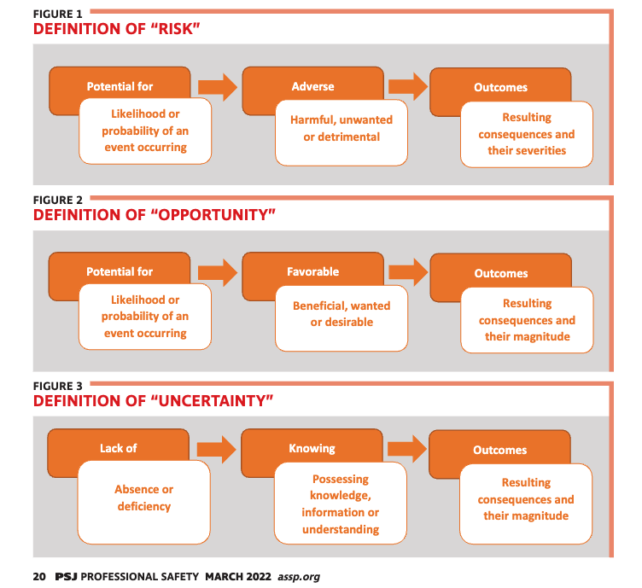
What is Risk?
Notes:
Lyon, Bruce K., and Georgi Popov. “On the Concept of Risk, Uncertainty & Black Swans.” Professional Safety 67, no. 03 (March 1, 2022): 18–23.

Slide 18
What are some risk domains?
Operational risk
This domain includes threats and vulnerabilities that arise from an organization's day-to-day activities, such as human error, supply chain disruptions, and business process failures.
Financial risk
This domain includes risks that arise from an organization's financial operations and management, such as credit risk, market risk, and liquidity risk.
Reputational risk
This domain includes risks that impact a company's reputation in the public and media.

Slide 19
What are some risk domains?
Strategic risk
This domain includes risks that are often addressed at the executive level, such as mergers, acquisitions, and brand reputation.
Human resources
This domain includes risks linked to the workforce, such as talent acquisition, retention, training, employee satisfaction, and availability.
Security risk
This domain includes risks related to classifying information and how an organization's information security function interacts with other areas.

Slide 20
Operational Risk Definition
Operational risk defined by Basel financial consortium in 2001 as “the risk of direct or indirect loss resulting from inadequate or failed internal processes, people and systems or from external events.”
The first mandate for leaders to adopt sound risk management and disclosure practices to shareholders came after Enron and Worldcom debacles with the Sarbanes-Oxley Act in 2002 (SOX).
Publicly traded companies must report quarterly to the Securities & Exchange Commission (SEC) and list significant risks they are managing or failures they are correcting.
Current example in the news is SEC fine of $200 million to Boeing on 737MAX for misleading investors
Notes:
ISO - International Standards Organization

Slide 21
Managing Risk
Accept
Mitigate
Transfer
Avoid

Slide 22
Risk Management Model
Risk management as an enabler
Strategic Objectives
Asset
Management
Risk Management
Performance Management
Notes:
ISO - International Standards Organization

Slide 23
Common Risks
Man-made disasters, terrorist acts, and natural disasters have a possible 10 risk factors in common
Design and construction flaws
Deferred maintenance
Economic pressures
Schedule constraints
Inadequate training
Not following procedures
Lack of plans, preparedness
Communications failure
Arrogance
Stifling political agenda
Notes:
ISO - International Standards Organization

Slide 24
Group Pair and Share
Get together with your group.
What are some of the common 10 risk factors that you have seen or been impacted by within an organization?
Notes:
ISO - International Standards Organization

Slide 25
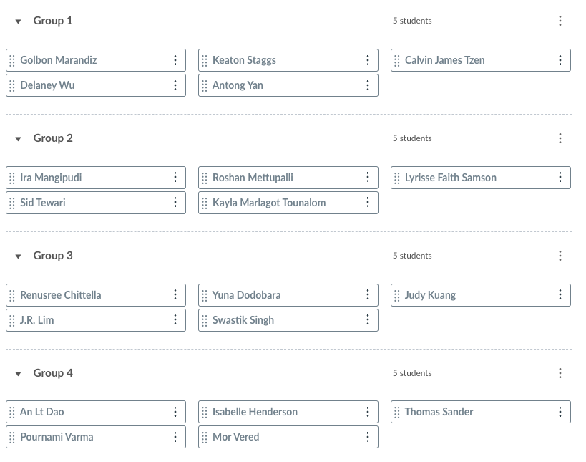
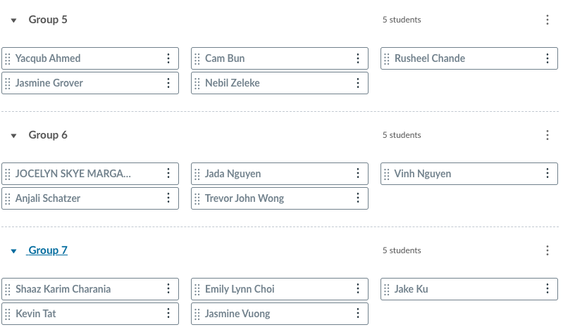
Who is in my group?

Slide 26
Group Presentations

Slide 27
Boeing Case-Study Review

Slide 28
Background: The Boeing Company
Founded in 1916 by William Boeing and his partner with single engine, two-seat airplane, as the Aero Company.
Renamed Boeing in 1917, based in Seattle.
Built “flying boats” for Navy in World War I, then many types of planes (including trainers) to military in 1920s and 1930s.
1928: Boeing Airplane and Transport Co., to include both manufacturing and airline operations.
Notes:
ISO - International Standards Organization

Slide 29
Background: The Boeing Company
Many other acquisitions of firms like Pratt & Whitney before 1934, when new antitrust laws made it break up manufacture from transport.
It became Boeing Airplane Company, one of three to emerge. (Others were United Airlines and United Technologies Corporation.)
Today: Boeing is $129B company w/ 171,000 employees
Notes:
ISO - International Standards Organization

Slide 30
Rough Timeline: Design under Pressure
Eleven years ago, Boeing 737 group of planes had large threat from rival Airbus and its 320 family when it announced the Airbus 320neo (new engine option) which would be more fuel-efficient
Boeing first opted for an entirely new design to be a competitor to the Airbus 320neo that was described as something “our customers will wait for” in Feb. 2011 by Boeing CEO James McNerney. It had an estimated date of the end of the decade
Notes:
ISO - International Standards Organization

Slide 31
Rough Timeline: Design under Pressure
But by August of that year, Boeing figured out customers would not wait and chose to put new engines on the 737 base, which sits closer to the ground than the Airbus family, which meant additional redesign done on what had previously been a common footprint family with common pilot training.
“We figured out a way to get a big enough engine under the wing.” (737 product development, March 2011)
Notes:
ISO - International Standards Organization

Slide 32
“Putting new engines on an old plane”
To get the engine under the 737 wing, engineers mounted the engine nacelle higher and more forward on the plane.
But that along with a change in the nose of plane changed the aerodynamics such that plane did not handle at a high angle of attack.
Notes:
ISO - International Standards Organization

Slide 33
“Putting new engines on an old plane”
This led to the creation of the Maneuvering Characteristics Augmentation System (MCAS), which fixed angle of attack problem in most situations but created new problems in other situations – it made it difficult for pilots to directly control the plane without being overridden by MCAS.
By that point, even with fixes, Boeing still argued it was same plane and no additional training in flight simulator necessary, just a short series of refreshers on iPad.
Notes:
ISO - International Standards Organization

Slide 34
Engine nacelle mounted higher & more forward to get 17” ground clearance
The nacelle features chevrons for noise reduction like the 787.^{[87]} A new bleed air digital regulator will improve its reliability.^{[88]} The larger engine is cantilevered ahead of and slightly above the wing, and the laminar flow engine nacelle lipskin is a GKN Aerospace one-piece, spun-formed aluminum sheet inspired by the 787.^{[34]}
The new Maneuvering Characteristics Augmentation System mitigates the pitch-up tendency of the new flight geometry due to the heavier engines being located further forward and higher than the previous ones.^{[89]}
-- Source here is Wikipedia, which normally I do not use, but which Boeing engineers contributed to.
Notes:
ISO - International Standards Organization

Slide 35
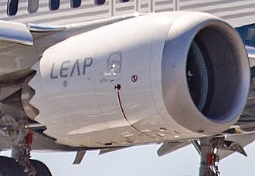
Engine nacelle mounted higher & more forward to get 17” ground clearance
In May 2012, Boeing further enlarged the fan to 69.4 in (176 cm), paired with a smaller engine core within minor design changes before the mid-2013 final configuration.^{[86]}
Notes:
ISO - International Standards Organization

Slide 36
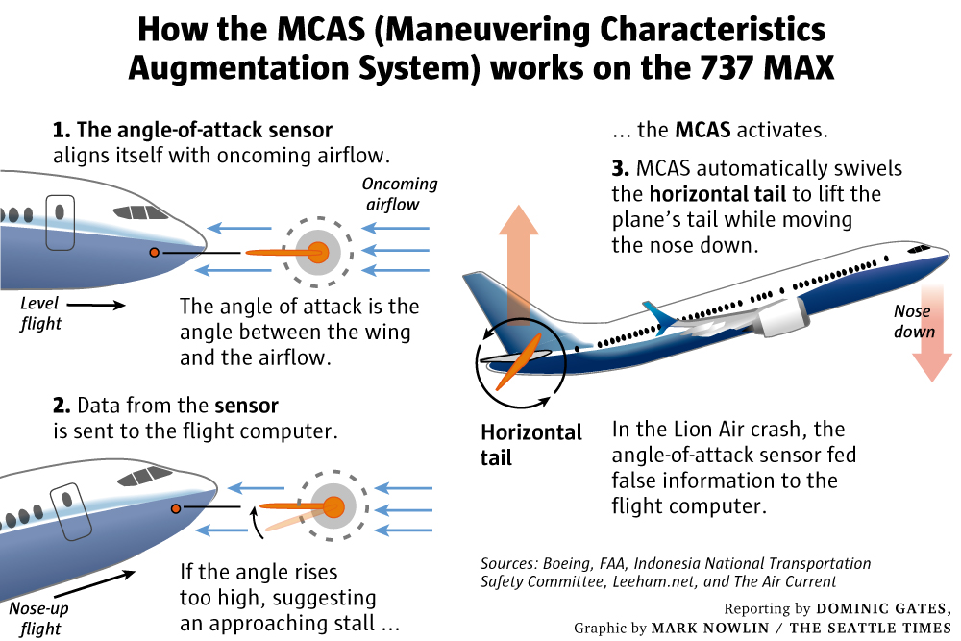

Seattle Times, March 17, 2019

Slide 37
Boeing’s MCAS System Safety Analysis
“Understated the power of the new flight control system, which was designed to swivel the horizontal tail to push the nose down to avert a stall. When planes entered service, MCAS was capable of moving the tail more than four times farther than was stated in the initial safety analysis document.
Failed to account for how the system could reset itself each time a pilot responded, thereby missing the potential impact of the system repeatedly pushing the airplane’s nose downward.
“Assessed the failure of the system as one level below ‘catastrophic.’ But even that hazardous danger level should have precluded activation of the system based on input from a single sensor—and yet that’s how it was designed.”
Notes:
“Understated the power of the new flight control system, which was designed to swivel the horizontal tail to push the nose down to avert a stall. When planes entered service, MCAS was capable of moving the tail more than four times farther than was stated in the initial safety analysis document.
“Failed to account for how the system could reset itself each time a pilot responded, thereby missing the potential impact of the system repeatedly pushing the airplane’s nose downward.
“Assessed the failure of the system as one level below ‘catastrophic.’ But even that hazardous danger level should have precluded activation of the system based on input from a single sensor—and yet that’s how it was designed.”
Dominic Gates, Seattle Times “Flawed analysis, failed oversight…” March 17, 2019

Slide 38
Pricing considerations outweighed safety
Evidently there are two sensors built into every 737MAX, but only one is deployed on the current standard model. That sensor measures the plane’s angle of attack, the angle between the wing and incoming air flow.
The failure of the one sensor in Ethiopia and in Indonesia crashes has been established from early black box data.
Neither Lion Air or Ethiopian Airlines had any indicators on their cockpit displays to tell give them readings from one or both sensors. Estimated cost of upgrade = $80,000
Extra price = two display features that illuminate when signals from sensors disagree and another to display angle of attack data. Allegedly, the disagree feature and the second sensor will now become standard features.
Notes:
Evidently there are two sensors built into every 737MAX, but only one is deployed on current standard model. That sensor measures the plane’s angle of attack, the angle between the wing and incoming air flow.
The failure of the one sensor in Ethiopia and in Indonesia crashes has been established from early black box data.
Neither Lion Air or Ethiopian Airlines had any indicators on their cockpit displays to tell give them readings from one or both sensors. Estimated cost of upgrade = $80,000
Extra price = two display features that illuminate when signals from sensors disagree and another to display angle of attack data. Allegedly, the disagree feature and the second sensor will now become standard features.

Slide 39
FAA Certification and Political Heft
FAA delegated crucial evaluations of the 737’s safety to Boeing, a process that has been happening more over the years due to a lack of funding and resources at the FAA.
Gates again: “as certification proceeded, managers prodded them to speed the process” and “when time was too short for FAA technical staff to complete a review, sometimes managers either signed off on the documents themselves or delegated their review back to Boeing.”
These managers were not the FAA’s technical experts but rather managers concerned about the timeline.
Notes:
FAA delegated crucial evaluations of the 737’s safety to Boeing, a process that has been happening more over the years due to a lack of funding and resources at the FAA.
Gates again: “as certification proceeded, managers prodded them to speed the process” and “when time was too short for FAA technical staff to complete a review, sometimes managers either signed off on the documents themselves or delegated their review back to Boeing.”
These managers were not the FAA’s technical experts but rather managers concerned about the timeline.
Boeing is an important vendor to the U.S. government, and spends massive dollars lobbying (estimated $15-21 million annually). It is also a company with a strong union presence and global exports.
FAA did not want to be seen as losing business to Europe because of their oversight. Certified the MAX8 as safe in 2017 after 5 years of work.
Obama administration was committed to Export-Import Bank and to Boeing maintaining its manufacturing leadership in the world.

Slide 40
FAA Certification and Political Heft
Boeing is an important vendor to the U.S. government, and spends massive dollars lobbying (estimated $15-21 million annually). It is also a company with a strong union presence and global exports.
FAA did not want to be seen as losing business to Europe because of their oversight. Certified the MAX8 as safe in 2017 after 5 years of work.
Obama administration was committed to Export-Import Bank and to Boeing maintaining its manufacturing leadership in the world.
Notes:
FAA delegated crucial evaluations of the 737’s safety to Boeing, a process that has been happening more over the years due to a lack of funding and resources at the FAA.
Gates again: “as certification proceeded, managers prodded them to speed the process” and “when time was too short for FAA technical staff to complete a review, sometimes managers either signed off on the documents themselves or delegated their review back to Boeing.”
These managers were not the FAA’s technical experts but rather managers concerned about the timeline.
Boeing is an important vendor to the U.S. government, and spends massive dollars lobbying (estimated $15-21 million annually). It is also a company with a strong union presence and global exports.
FAA did not want to be seen as losing business to Europe because of their oversight. Certified the MAX8 as safe in 2017 after 5 years of work.
Obama administration was committed to Export-Import Bank and to Boeing maintaining its manufacturing leadership in the world.

Slide 41
Two Catastrophic Crashes of the 737MAX
Lion Air Flight 610 in October of 2018
Into Java Sea, Indonesia
189 dead
20 passengers were members of Indonesian Ministry of Finance
Ethiopian Airlines Flight 302 in March of 2019
Trouble upon takeoff from Abbas Ababa
149 dead
22 United Nations personnel aboard

Slide 42
Two Catastrophic Crashes of the 737MAX
The first analyses looked like probable pilot inexperience/error.
Under pressure, the Federal Aviation Authority grounded the planes from later in March 2019 through December of 2020, though it took longer in some locations for the plane to be allowed to fly again (pilot retraining, plane maintenance and upgrades).

Slide 43
Economic Risk Realization
Boeing has lost billions in stock market valuation since the second crash.
Manufacturing of the 737MAX was suspended and planes were stockpiled by Boeing while the plane was grounded.
Impact to airlines who own the plane in bulk are also staggering.
They had to find storage space for their grounded planes.
They had to find other planes to put in service or reduce service.
Some of the pilots and flight attendants declared the plane unsafe.
Investor confidence as well as the confidence of air travel passengers has been affected.

Slide 44
Hard Costs
From The Guardian in March of 2020:
“Boeing has put the total cost of the two deadly crashes of its 737 Max airliners at nearly $19bn (£14.6bn) and slumped to its first annual loss in more than two decades.
The US manufacturing giant lost $1bn in the fourth quarter as revenue plunged 37% after the worldwide grounding of the 737 Max. The company has suspended new deliveries of the plane in the wake of the biggest crisis in its 103-year history. Over the whole of 2019, Boeing lost $636m.
Boeing set aside a further $9.2bn to cover the costs of airlines that have cancelled thousands of Max flights and towards higher costs related to compensation – doubling its estimate of the total financial hit from the crisis to $18.6bn.”

Slide 45
Hard Costs - Fines
Fines:
“On January 7, 2021, Boeing settled to pay over $2.5 billion after being charged with fraud over the company's hiding of information from safety regulators: a criminal monetary penalty of $243.6 million, $1.77 billion of damages to airline customers, and a $500 million crash-victim beneficiaries fund.”
Boeing recently fined $200 million by the Securities & Exchange Commission for misleading investors.

Slide 46
Back in the Air - December 2020
The new and improved 737MAX has been certified by the FAA and is now back in the air. Fixes have been made to all planes and pilot retraining has taken place.
U.S. House of Representatives report characterizes “a disturbing pattern of technical miscalculations and troubling management misjudgments made by Boeing,” with “grossly insufficient oversight by the FAA.” Legislation is on its way.
In addition to cost and lost sales, the reputational damage inflicted on Boeing is significant
Deaths
Safety
A culture of arrogance (General Electric/Welch approach)

Slide 47
Discussions on Risk
Sit with your group and discuss the following questions:
What are some of the risks that you identified during this case study?
What risk areas were overlooked?

Slide 48
Introductions
Your name
Your major or specialization
Where would you like to be five years from now in your career?

Slide 49
Argument Definitions and Structure

Slide 50
Argument Defined
a coherent series of reasons, statements, or facts intended to support or establish a point of view
a reason given for or against a matter under discussion
Notes:
https://www.youtube.com/watch?v=ohDB5gbtaEQ

Slide 51
Arguments Structure
A. Argument - a set of declarative statements with one statement being argued for (the conclusion), and other statements (premises) given as support or proof.
1. Premise - what is given as support or evidence for a conclusion.
2. Conclusion - what follows from the premises, what is being claimed.
Notes:
https://www.youtube.com/watch?v=ohDB5gbtaEQ

Slide 52
Premises
A good premise is an objectively clear and specific statement. In other words, a good premise is refutable
Refutable
able to be proven false
IT CAN BE EITHER TRUE OR FALSE
Examples
For each of the next Poll Everywhere examples determine if the example is refutable or not
Notes:
https://www.youtube.com/watch?v=ohDB5gbtaEQ

Slide 53
Refutable Statement Examples
 | TRUE | FALSE
REFUTABLE | The sun rises every morning in the east. | The sun rises every morning in the west.
NOT REFUTABLE | Reifers is the best professor ever. | Invisible and undetectable unicorns exist on planet Earth.
Notes:
https://www.youtube.com/watch?v=ohDB5gbtaEQ

Slide 54
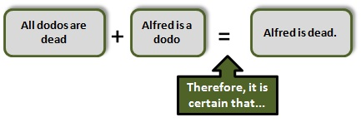
Deductive Arguments
Deductive Argument - an argument where the conclusion is conclusively supported by the premises

Slide 55
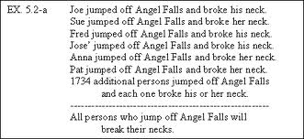
Inductive Arguments
Inductive Argument - an argument where the conclusion is only strongly supported by the premises

Slide 56
Qualities Of Deductive Arguments: Validity And Soundness.
In deductive logic, there are two main terms of argument evaluation: valid and sound.
Valid is defined as:
well-grounded or justifiable: being at once relevant and meaningful
logically correct
Notes:
To begin with validity. There are several different ways to define this, but the definitions are all equivalent, i.e., they all mean the same thing. Think of it whatever way suits you.
“Definition of VALID,” March 15, 2024. https://www.merriam-webster.com/dictionary/valid.

Slide 57
A definition of "sound":
An argument is sound if, and only if, it is valid and all of its premises are true.
So Soundness = Validity + True Premises.
Some valid arguments are not sound: they have false premises.
Notice: if you know that an argument is sound, then you do know that the conclusion is true. Why? (Hint: look at the definitions of "valid" and "sound.")

Slide 58
Qualities Of Inductive Arguments: Strength And Cogency.
What validity and soundness, respectively, are for deductive arguments, strength and cogency, respectively, are for inductive arguments.
Def. An (inductive) argument is strong if, and only if, supposing the premises are true, then it is probable (but not absolutely necessary) that the conclusion is true

Slide 59
A definition of ”cogency":
An inductive argument is cogent if, and only if, it is strong and all of its premises are true.
So Cogency = Strength + True Premises.
Some strong arguments are not cogent: they have false premises.

Slide 60
Argument Examples
A. Inductive Arguments
1. I have seen one swan and it was white
2. I have seen a second swan and it was white
3. I have seen n swans and they were all white
4. So, all swans are white
B. Deductive Argument
If it is raining out then the grass is wet
It is raining out
So, the grass is wet

Slide 61
Fallacies
AKA Bad Ways to Argue

Slide 62
Argument against the Person (abusive)
"You shouldn't believe what this person says, because he is a communist”
"Ayn Rand had to be wrong, because she was an atheist.”
"Only an immature person would advocate such a position. Grow up!”
"When I was young and inexperienced I thought the way you do."

Slide 63
Argument against the Person (circumstantial)
"Say, are you not a republican? — that means that you should agree with my position that the government should stay out the of economy.”
"As a member of the clergy, how can you not think that the argument from design works — don't you believe in God?"

Slide 64
Argument against the Person (tu quoque)
"You don't live by your own principles, so who should believe you?“
"Thou shall not kill, is a tenant of your religion — yet look at all of the killing you people do?”
Child N: ” OW! Stop hitting me! ”
Child A: ” This is what you get for hitting me yesterday! ”
Notes:
"Tu quoque" is a Latin phrase that translates to "you also" or "you too" in English. In rhetoric and logic, it refers to a fallacy where an argument's validity is dismissed by pointing out the hypocrisy of the person making the argument. Essentially, instead of addressing the argument itself, the responder deflects by accusing the other person of the same behavior or fault. This fallacy is often used to avoid addressing the actual merits of an argument and instead focuses on attacking the person making the argument.

Slide 65
Appeal to Pity
Clarence Darrow: I appeal to you not for Thomas Kidd, but I appeal to you for the long line — the long, long line reaching back through the ages and forward to the years to come — the long line of despoiled and downtrodden people of the earth. I appeal to you for those men who rise in the morning before daylight comes and who go home at night when the light has faded from the sky and give their life, their strength, their toil to make others rich and great. I appeal to you in the name of those women who are offering up their lives to this modern god of gold, and I appeal to you in the name of those little children, the living and the unborn.

Slide 66
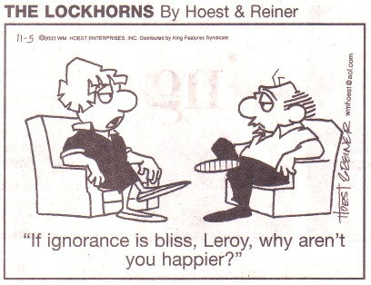
Appeal to Ignorance
"There must be ghosts because no has ever been able to prove that there aren't any."
"You can't show that God doesn't exist, so he must exist.“
You can’t prove that privacy rights exist so they don’t
(Exception: court of law — innocent until proven guilty).

Slide 67
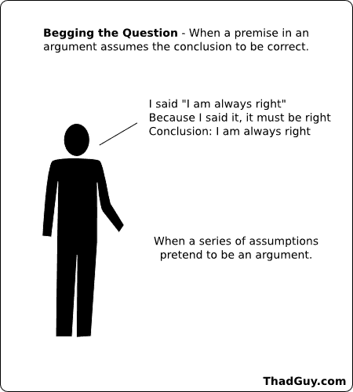
Begging the Question
"To allow every man unbound freedom of speech must always be, on the whole, advantageous to the state/society; because it is highly conductive to the interests of the community that each individual should enjoy a liberty, perfectly unlimited, of expressing his sentiments.”
The premise (“it is highly conductive . . ) is logically irrelevant to the purpose of proving or establishing the conclusion (“To allow every man unbound freedom . . “).

Slide 68
Complex Question
"Have you ever stopped beating your wife?“
"Did you ever get over that drug problem of yours?“
"Have you stopped spying on your neighbors?

Slide 69
False Dichotomy
“Either we adopt universal health care or allow anarchy to reign supreme in medicine by not legislating at all.”
Either individuals have intellectual property rights or there is no property at all.
We can allow total information awareness by the NSA or let the terrorists win

Slide 70
Affirming the Consequent
If P then Q
Q
Therefore P
If it is raining out then the grass is wet.
The grass is wet.
So, it is raining out.
If there are intellectual property rights, then file sharing is wrong.
File sharing is wrong
So, there are intellectual property rights
Note how this form is different
If P then Q
P
Therefore Q

Slide 71
Denying the Antecedent
Note how this form is different
If P then Q
Not Q
Therefore Not P
If P then Q
Not P
Therefore Not Q
If it is raining out then the grass is wet.
It is not raining out.
So, the grass is not wet.
If there are intellectual property rights, then file sharing is wrong.
There are no intellectual property rights
So, file sharing is not wrong (it is right?)

Slide 72
Composing an Argument

Slide 73
Step 1
Distinguish premises from conclusions
The first thing to note is that when someone is giving an argument, try to be careful about what they are arguing for, i.e. the conclusion, and the evidence they are giving in support of that conclusion, or the premises.
Notes:
https://www.youtube.com/watch?v=ohDB5gbtaEQ

Slide 74
Step 2
Present ideas in a natural order
When giving an argument try to present the premises and conclusions in a natural way. Play around with the order of your ideas so that you can come up with a natural progression that leaves little doubt about your views and reasons.
Notes:
https://www.youtube.com/watch?v=ohDB5gbtaEQ

Slide 75
Step 3
Start from reliable premises
Always start an argument with reliable premises. Also, do not overstate the case in your premises. An example of this can be seen in the following: "Nobody in the world today is really happy." This premise needs some defense and is likely not true.
Notes:
https://www.youtube.com/watch?v=ohDB5gbtaEQ

Slide 76
Step 4
Use definite, specific, concrete language
Avoid using abstract, vague, and general terms when making your arguments. Use specific and concrete language where the meanings are relatively clear.
Notes:
https://www.youtube.com/watch?v=ohDB5gbtaEQ

Slide 77
Step 5
Avoid loaded language
Try to avoid using loaded language when making your arguments. Do not distort counter arguments. Try to understand the opposing view, even if you disagree.
Notes:
https://www.youtube.com/watch?v=ohDB5gbtaEQ

Slide 78
Step 6
Use consistent terms
Arguments depend on clear connections between their premises and conclusions. Therefore, use a single set of terms for each idea to avoid confusion.
Notes:
https://www.youtube.com/watch?v=ohDB5gbtaEQ

Slide 79
Step 7
Keep to one meaning for each term
The fallacy of equivocation occurs when a key term or phrase in an argument is used in an ambiguous way. Ensure consistency in the use of terms throughout your argument to avoid equivocation.
Notes:
https://www.youtube.com/watch?v=ohDB5gbtaEQ

Slide 80
Group Debate Prep

Slide 81
Group Work – Debate Preparation
With your group, start preparing for your debate by researching information regarding the risk events assigned to you.
Post potential arguments that you could make regarding your assigned debate.
Please cite your sources for any specific statistics or information that could be used in your debate.

